Slide 1

Electricity Demand and Price Prediction
Presented by – ALOK Raj HANS
Dated: 19 July 2024

Slide 2
Problem Statement:
Develop a machine learning model to accurately forecast electricity demand and it’s prices.
Performing Exploratory Data Analysis, data pre-processing, Feature engineering and Data visualization.
Analyze various machine learning models like
Linear Regression
Random Forest
Gradient Boosting
Long Short-Term Memory
Conclude and make a final report with the best suitable model with least errors and also observe the important features related to that model.

Slide 3
Content
Dataset Introduction
Data Pre-processing
Feature Engineering
Data Visualization
Machine Learning Models
Final Report
Conclusion

Slide 4
1. Dataset Introduction
Two provided datasets are namely ‘weather_features’ and ‘energy_dataset’.
Weather_features dataset
Consists of 17 columns and 178396 rows.
Some of these columns are temp, pressure, humidity, wind_deg.
Columns related to weather variables.
Energy_dataset
Consists of 29 columns and 35064 rows.
Some of these columns are generation fossil gas, total load actual, price actual.
Columns related to energy generation using various methods.
Historical values in this dataset are recorded hourly from 2014-12-31 to 2018-12-31.
‘datetime’ column is in the format YYYY-MM-DD HH:MM:SS

Slide 5
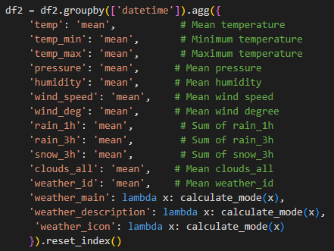
2. Data Pre-processing
Aggregation of ‘weather_features’ dataset at city level.
Taking mean of numerical values and mode for non-numerical values.
Merging of ‘weather_features’ and ‘energy_dataset’ using left join.
Null value treatment
Null value present in all row of any column:
Taking its sum and if found zero then removing that column. Got these columns whose sum is zero: 'generation fossil coal-derived gas', 'generation fossil oil shale', 'generation fossil peat', 'generation geothermal', 'generation hydro pumped storage aggregated', 'generation marine', 'generation wind offshore', 'forecast wind offshore day ahead'
Null value present in any row
Using bfill() and ffill() to fill those null values.

Slide 6
2. Data Pre-processing Contd…
Outliers Treatment
Using IQR (Inter Quantile Range) method to detect outliers.
Values that are below Q1 - 1.5 * IQR or above Q3 + 1.5 * IQR are Outliers
where Q1 and Q3 are the 25th and 75th percentiles, respectively.
Using Upper bound and lower Bound capping technique to handle these outliers.

Slide 7
3. Feature Engineering
Creating new columns like ‘hour’, ‘month’, ‘day’, ‘weekday’, ‘is_weekend’.
Using label encoding for these columns weather_main, weather_description and weather_icon.
Categorizing hour as ‘peak hour’ and ‘off-peak hour’ based on energy demand.
Peak hours : 9 to 12 and 18-19 & Off-Peak hours : 0 to 4 and 23.
Binary encoding months into seasons as: (12, 1, 2) as ‘winter’ , (3, 4, 5) as ‘spring’, (6,7,8) as summer, (9,10,11) as fall
Similarly binary encoding ‘is_weekend’ column as True to be 1 and False to be 0.

Slide 8
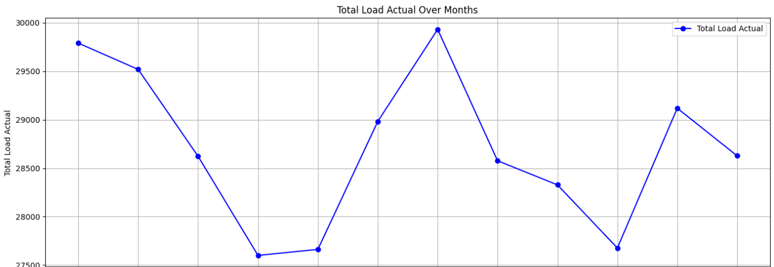
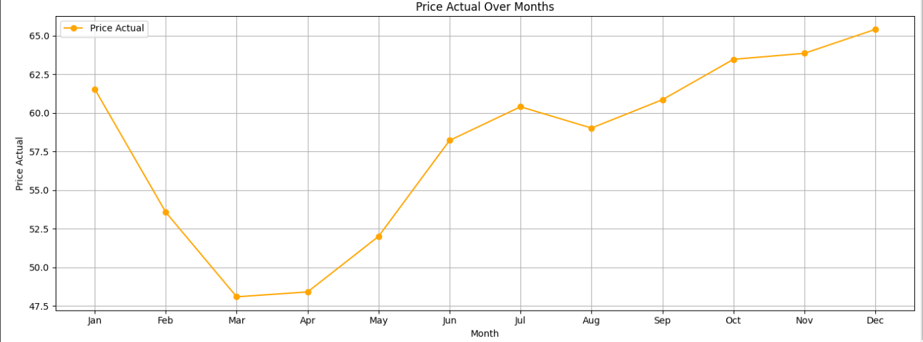
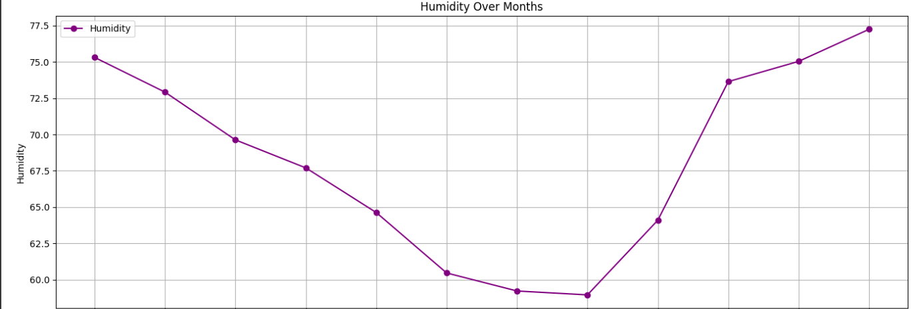
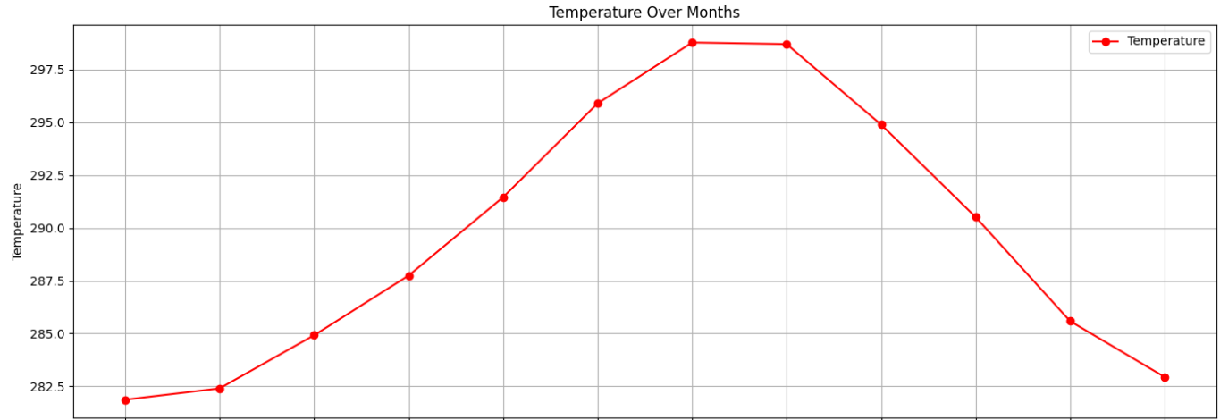
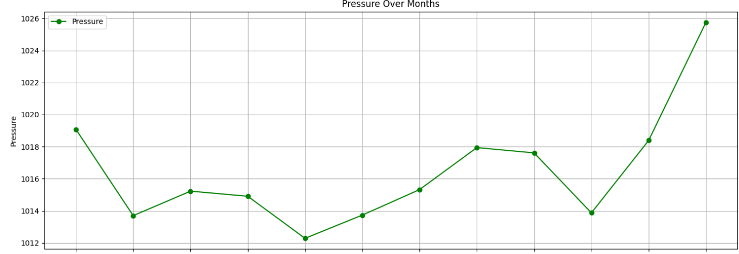
4. Data Visualization
Plotting separate line charts with ‘datetime’ column as x axis aggregated by month and at y axis these values
Total load actual, temperature, pressure, humidity and price actual.

Slide 9
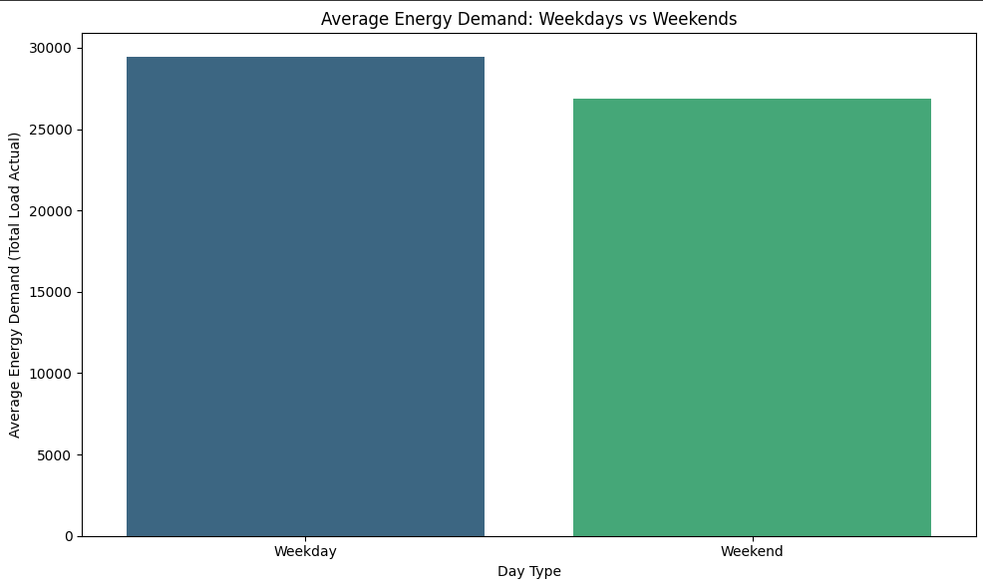
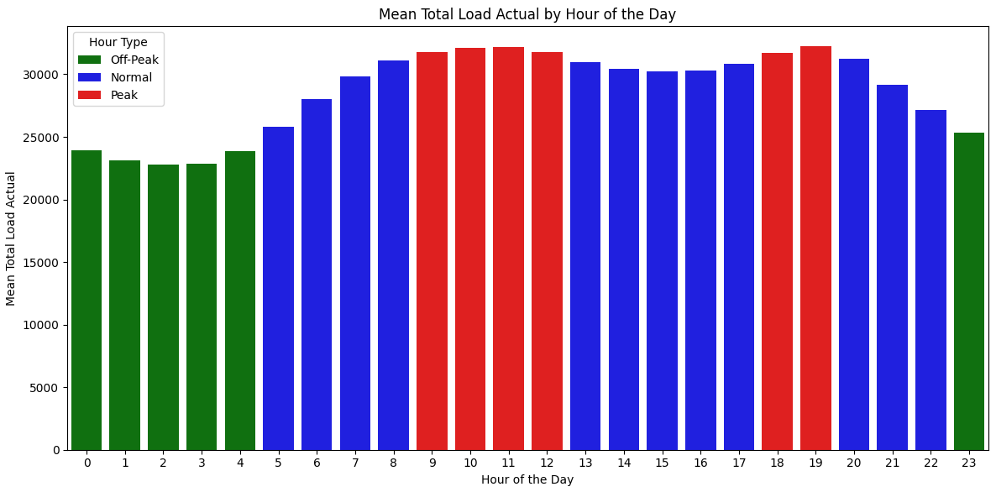
4. Data Visualization Contd…
Generally weekday have more energy demand than weekends.
Peak hour for energy demand are: 9-12 & 18-19
Off-Peak hour for energy demand are: 0-4 & 23

Slide 10
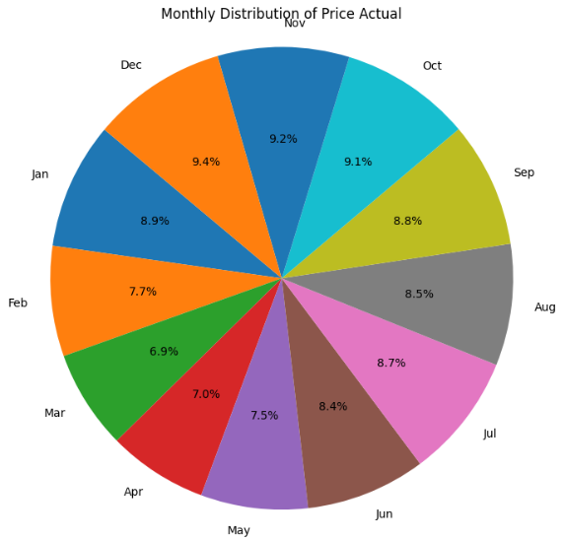
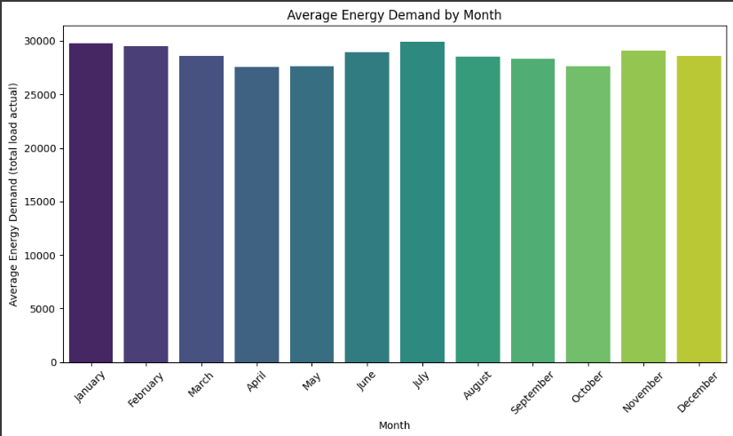
4. Data Visualization Contd…

Slide 11
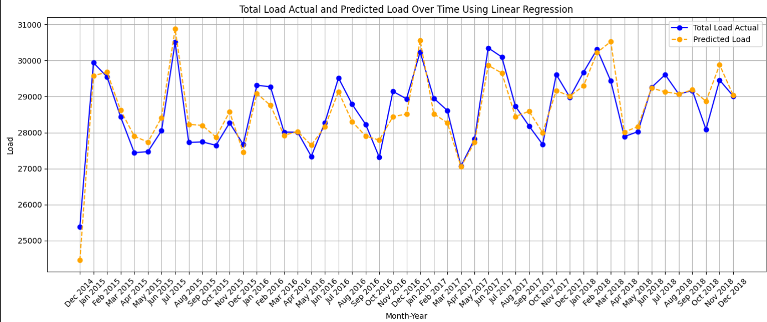
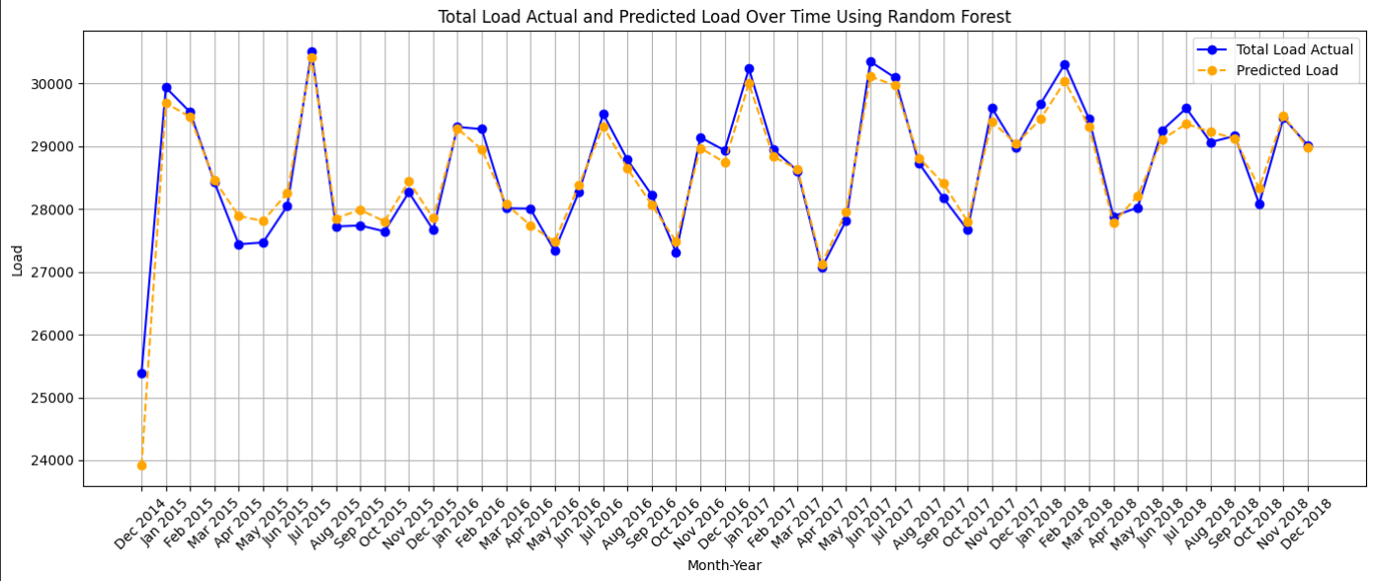
5. Machine Learning Models
Plotting total load actual and Predicted load as y axis and datetime at x axis.
MSE | 1595417.25
R2 | 0.92
ADJ R2 | 0.92
MAPE | 0.04
MAE | 987.65
Linear Regression Model Plot (MAPE: 0.04)
MSE | 1369580.05
R2 | 0.93
ADJ R2 | 0.93
MAPE | 0.03
MAE | 884.83
Random Forest Model Plot (MAPE: 0.03)

Slide 12
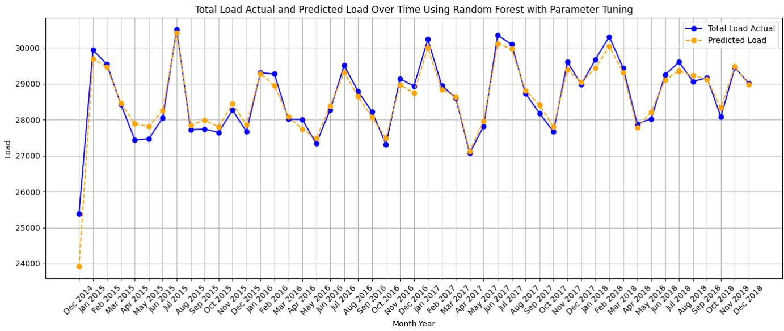
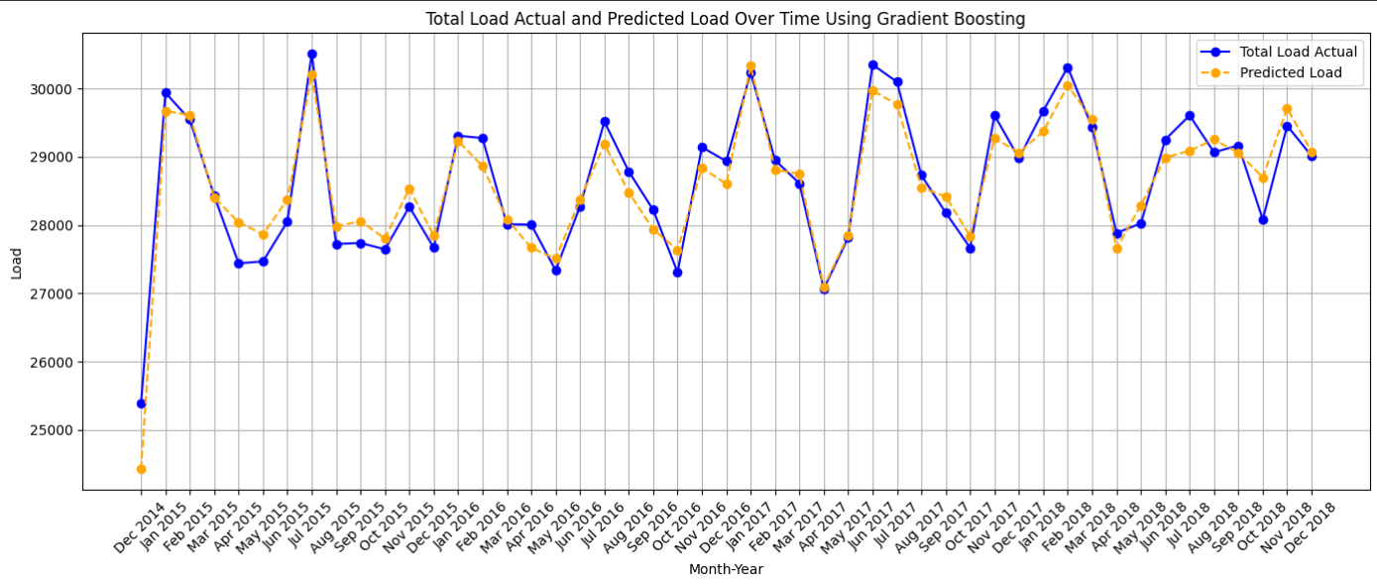
5. Machine Learning Models
Plotting total load actual and Predicted load as y axis and datetime at x axis.
MSE | 1160731.21
R2 | 0.94
ADJ R2 | 0.94
MAPE | 0.03
MAE | 822.75
Random Forest with Parameter Tuning (MAPE: 0.03)
MSE | 1514348.70
R2 | 0.93
ADJ R2 | 0.93
MAPE | 0.03
MAE | 961.76
Gradient Boosting Model Plot (MAPE: 0.03)

Slide 13
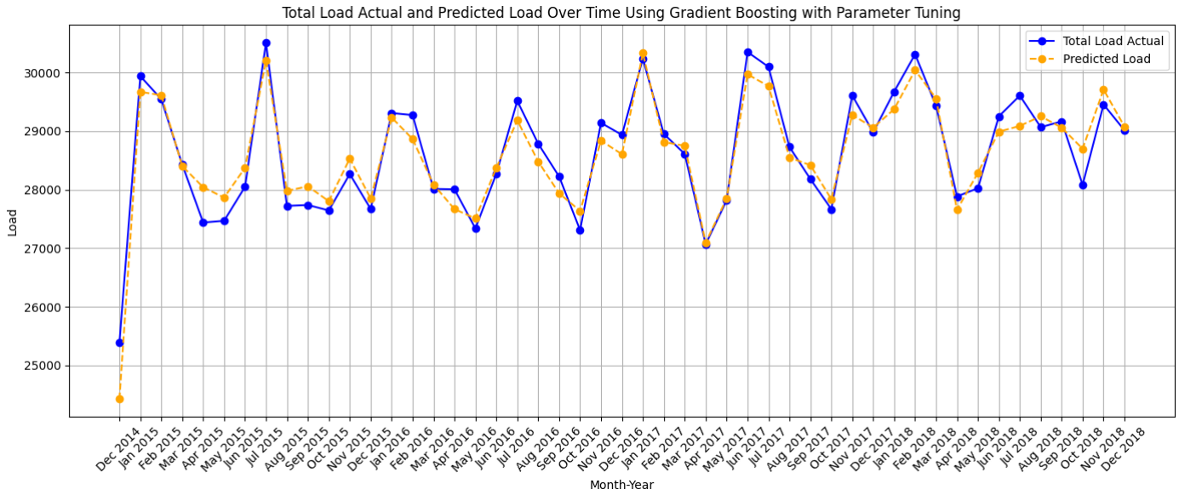
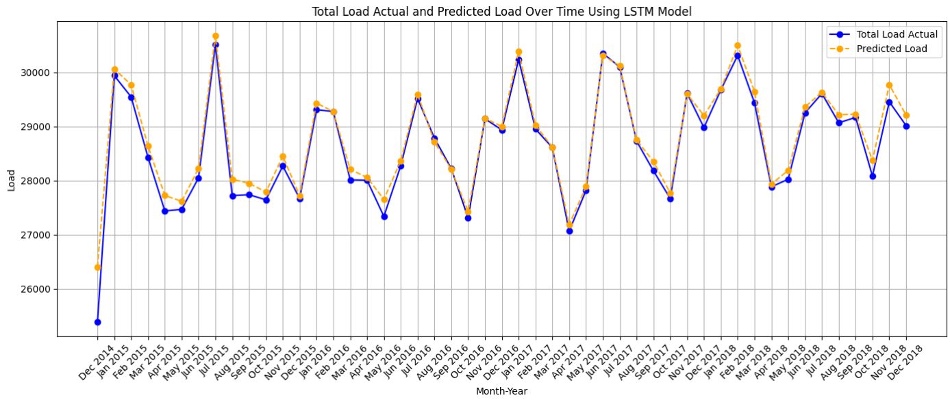
5. Machine Learning Models Contd…
Plotting total load actual and Predicted load as y axis and datetime at x axis. Contd….
MSE | 967143.57
R2 | 0.95
ADJ R2 | 0.95
MAPE | 0.03
MAE | 766.58
Gradient Boosting with Parameter Tuning Model Plot (MAPE: 0.03)
MSE | 871004.26
R2 | 0.96
ADJ R2 | 0.96
MAPE | 0.03
MAE | 717.43
LSTM Model Plot (MAPE: 0.03)

Slide 14
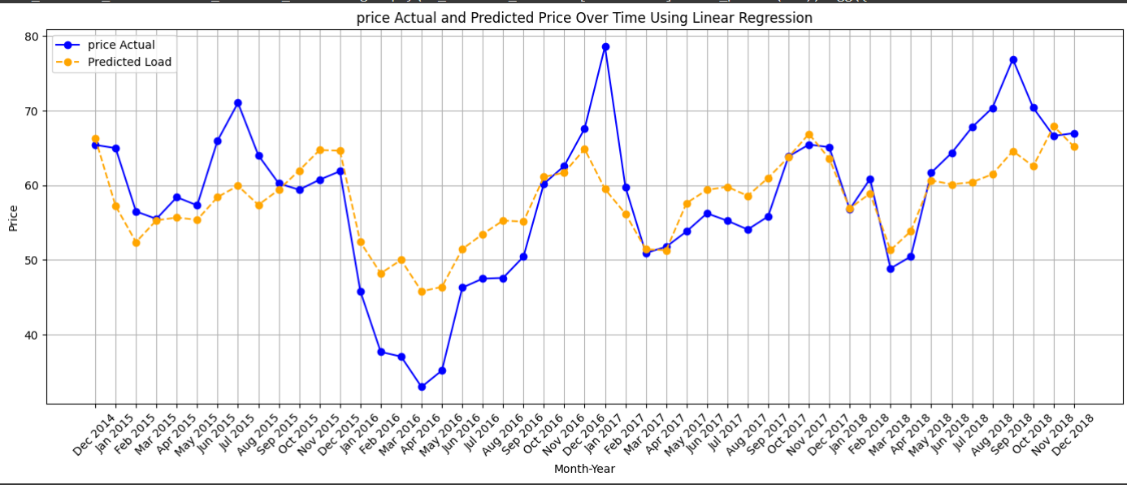
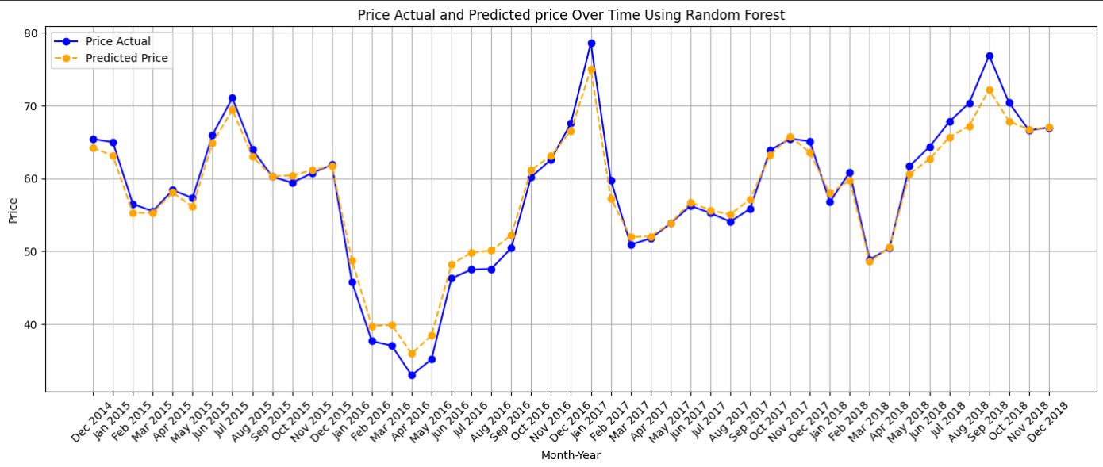
5. Machine Learning Models Contd…
Plotting total Price actual and Predicted price as y axis and datetime at x axis.
MSE | 96.93
R2 | 0.50
ADJ R2 | 0.49
MAPE | 0.15
MAE | 7.65
Linear Regression Model Plot (MAPE: 0.15)
MSE | 27.61
R2 | 0.86
ADJ R2 | 0.86
MAPE | 0.07
MAE | 3.75
Random Forest Model Plot (MAPE: 0.07)

Slide 15
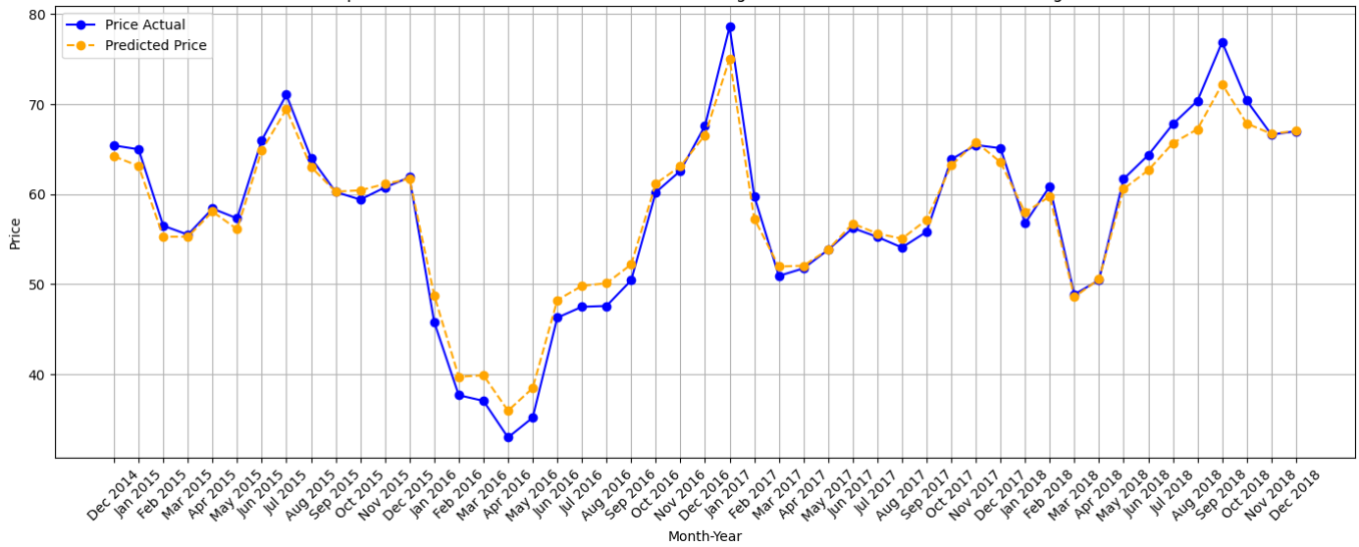
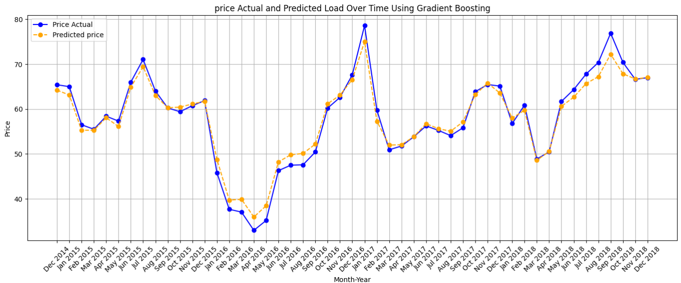
5. Machine Learning Models Contd…
Plotting total Price actual and Predicted price as y axis and datetime at x axis.
Random Forest with Parameter Tuning (MAPE: 0.07)
MSE | 27.03
R2 | 0.86
ADJ R2 | 0.86
MAPE | 0.07
MAE | 3.76
MSE | 51.36
R2 | 0.73
ADJ R2 | 0.73
MAPE | 0.11
MAE | 5.52
Gradient Boosting Model Plot (MAPE: 0.11)

Slide 16
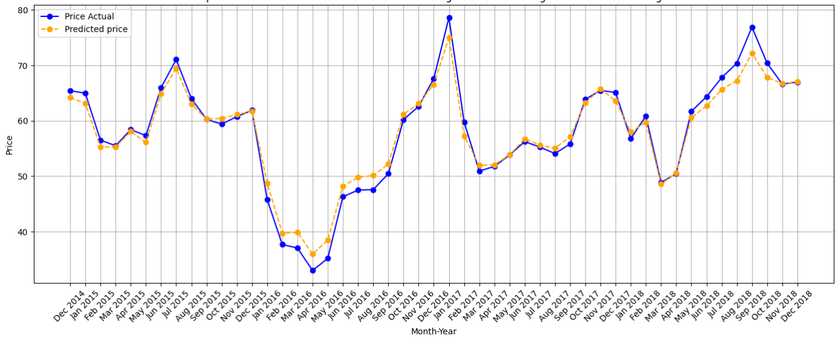
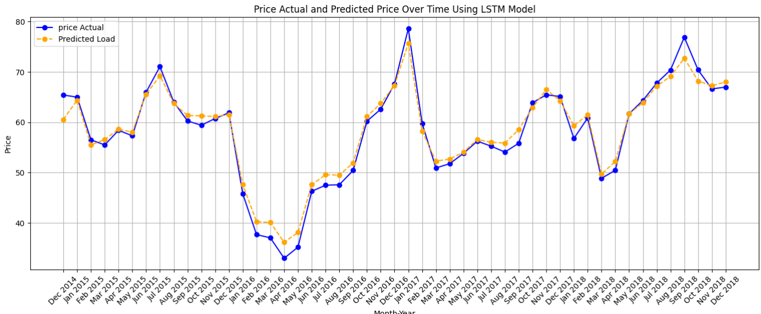
5. Machine Learning Models Contd…
Plotting total Price actual and Predicted price as y axis and datetime at x axis. Contd….
MSE | 36.66
R2 | 0.83
ADJ R2 | 0.83
MAPE | 0.08
MAE | 4.37
Gradient Boosting with Parameter Tuning Model Plot (MAPE: 0.08)
MSE | 25.24
R2 | 0.87
ADJ R2 | 0.87
MAPE | .0.07
MAE | 3.78
LSTM Model Plot (MAPE: 0.07)

Slide 17
6. Final Report
LSTM Model for Load Prediction and Price Prediction is the best models among all those models with MAPE as 0.03 and 0.07 respectively.
MSE | 871004.26
R2 | 0.96
ADJ R2 | 0.96
MAPE | 0.03
MAE | 717.43
LSTM Model Plot(For Load) (MAPE: 0.03)
LSTM Model Plot (For Price) (MAPE: 0.07)
MSE | 25.24
R2 | 0.87
ADJ R2 | 0.87
MAPE | .0.07
MAE | 3.78

Slide 18
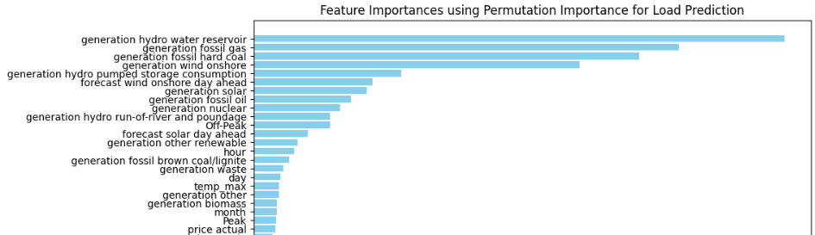
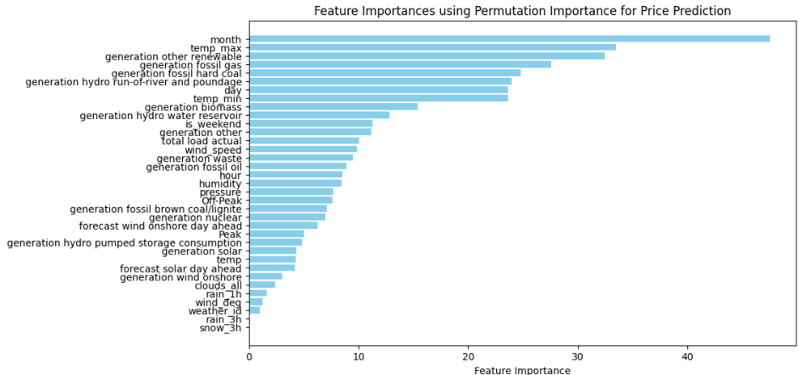
6. Final Report Contd…
LSTM Model for Load Prediction and Price Prediction is the best models among all those models with MAPE as 0.03 and 0.07 respectively.

Slide 19
7. Conclusion
Scalability of this project:
Data Handling:
Scalable for large datasets with real-time ingestion.
Infrastructure:
Cloud-based scaling.
Feature Engineering:
Automated feature selection and integration.
Handles new data sources effortlessly.
Model Performance:
Efficient algorithms (Random Forest, Gradient Boosting, LSTM).
Parallelized processing for faster results.
Training and Deployment:
Distributed Frameworks (TensorFlow).

Slide 20
THANK YOU!

